Slide 1

SMART INDIA HACKATHON 2026
TITLE PAGE
Problem Statement ID –SIH260088
Problem Statement Title- Virtual Reality & WebGL CBRN Emergency Simulator
Theme-Disaster Management (NDRF / MHA)
PS Category- Software
Team ID-
Team Name (Registered on portal)

Slide 2

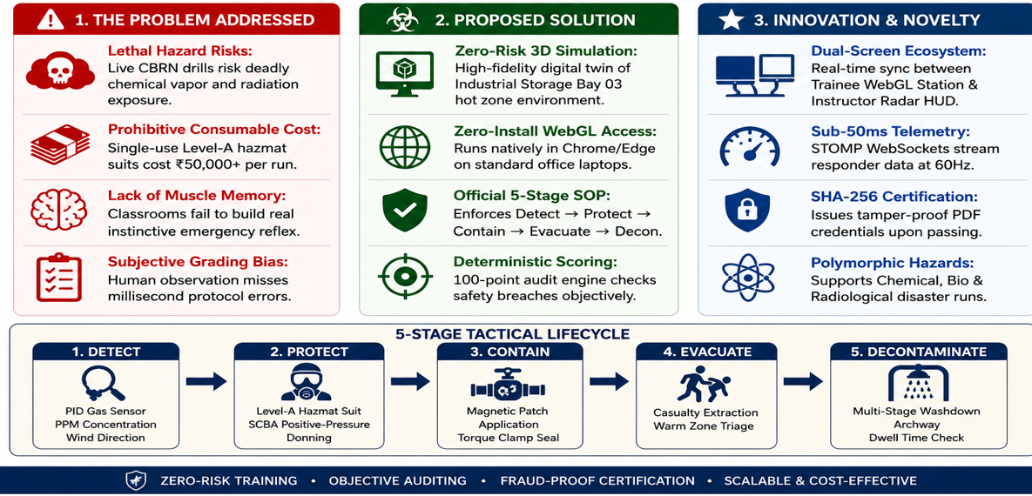
IDEA TITLE

Slide 3
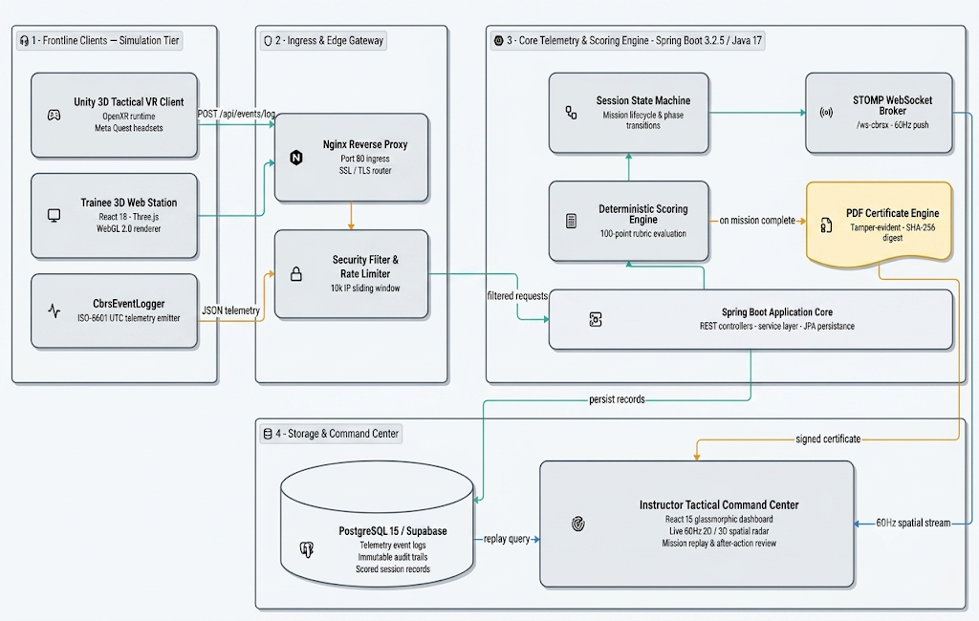
TECHNICAL APPROACH
🛠️ TECHNOLOGY STACK
Unity + WebGL – VR simulation environment
React + Three.js – Trainee monitoring interface
Java + Spring Boot – Backend and real-time communication
PostgreSQL – Secure storage of trainee data and results
🔄 HOW IT WORKS
Simulate → Capture Actions → Evaluate Performance → Live Monitoring → Generate Certificate
Tracks trainee actions in real time
Automatically calculates a 100-point performance score
Instructor can monitor trainees through a live tactical view
Generates a secure, tamper-proof certificate
🏆 PERFORMANCE
✔ 46/46 Tests Passed ✔ Supports up to 10,000 IP requests ✔ Smooth 60 FPS VR/WebGL experience

Slide 4
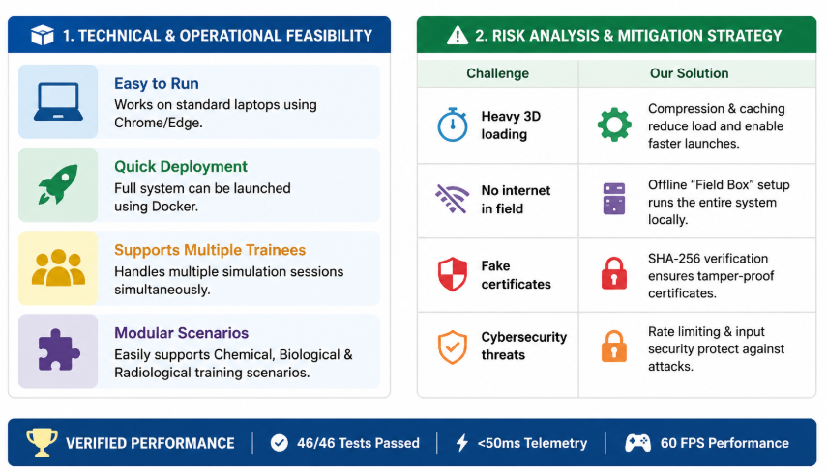
FEASIBILITY AND VIABILITY
@SIH Idea submission- CBRN-X by TechMinded
4

Slide 5
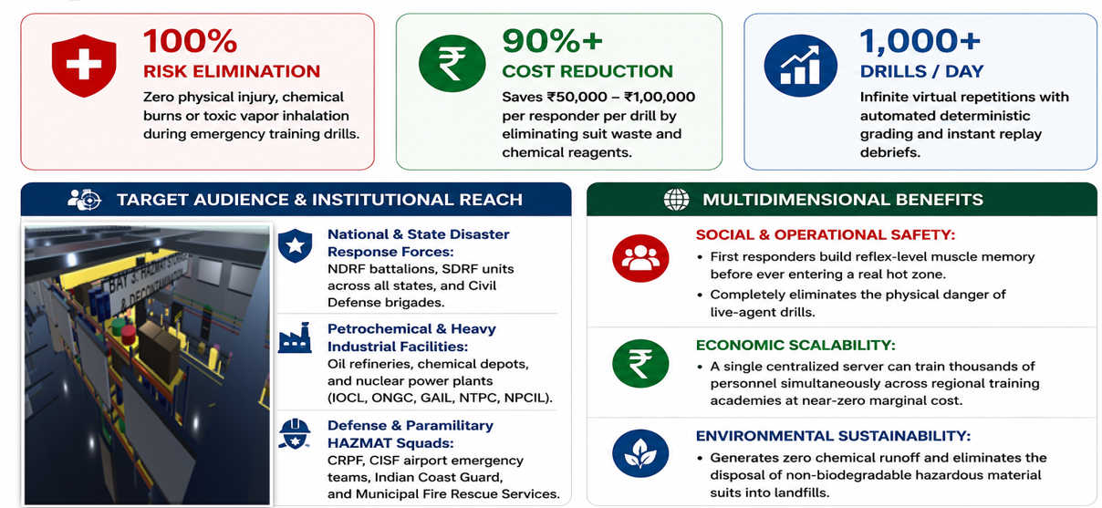
IMPACT AND BENEFITS
@SIH Idea submission- CBRN-X by TechMinded

Slide 6
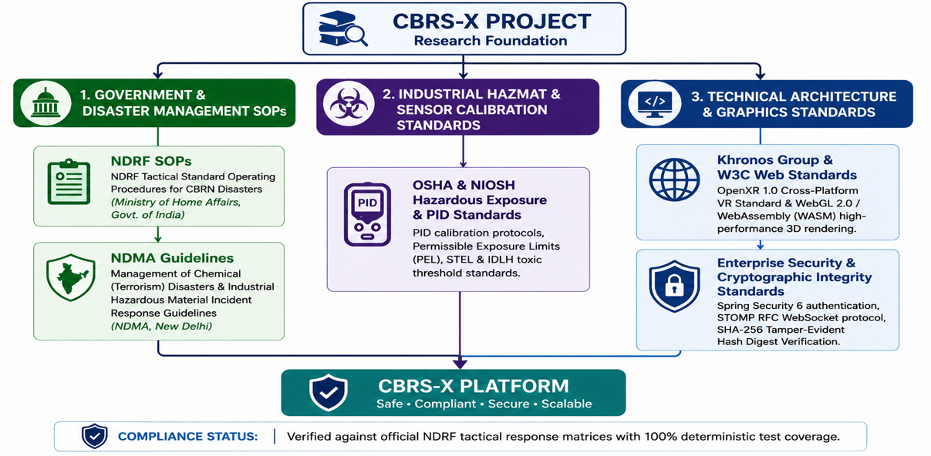
RESEARCH AND REFERENCES
@SIH Idea submission- CBRN-X by TechMinded

